Slide 1

EXPERIMENTAL RESEARCH In CS, IS and IT
RESEARCH METHODOLOGY AND SCIENTIFIC WRITING
COMPUTER SCIENCE FACULTY, UNIVERSITY OF INDONESIA

Slide 2


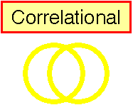


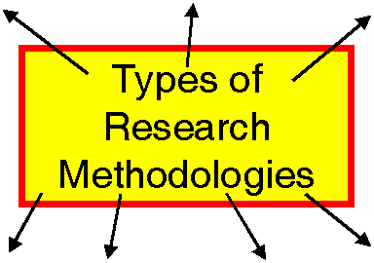








Research Methods (upon which methodologies can be built)
Case Study
Types of Research Methods

Slide 3

Experimental Group Designs Three Types
l_____________l_____________l
Experimental
Non-experimental
Quasi-experimental

Slide 4
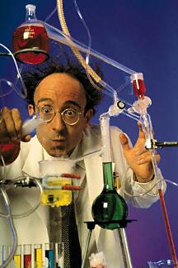
Experimental Reserach

Slide 5
What is Experimental Design?
An experimental design:
“Is the traditional approach to conducting quantitative research”
Sumber: Creswell, J.C. 2005
Treatment, control, comparison
Do something to subjects (guinea pigs?)
Who are randomly selected and randomly assigned to groups
For the purpose of determining the cause of an effect (difference between groups)

Slide 6

Characteristics of Experiments
Random assignment
Control over extraneous variables
The random assignment of individuals to groups (or condition within a group) distinguishes a rigorous’ “true” experiment from an adequate, but less-than-rigorous, “quasi-experiment”.
Manipulation of the treatment conditions
Outcome measures
Group comparisons
Threats to Validity

Slide 7
Experimental Research
Experiment: The investigation of the relationship between two or more variables by deliberately producing a change in one variable in a situation and observing the effects of that change on other aspect of the situation.
Cause-and-effect
Experimental manipulation: Change that an experimenter deliberately produces in a situation
Treatment: the manipulation implemented by experimenter
Experimental group: any group receiving a treatment in an experiment
In an observational study, measurements of variables of interest are observed and recorded, without controlling any factor that might influence their values.
An experiment, on the other hand, deliberately imposes some treatment on individuals in order to observe their responses.
In principle, only experiments can give good evidence for causation.

Slide 8
Steps In Conducting Experimental Research
Step 1. Decide if an experiment addresses your research problem
Step 2. Form hypotheses to test Cause-and-effect Relationships
Step 3. select an Experimental Unit and Identify Study participants
Step 4. Select an Experimental Treatment and Introduce it
Step 5. Choose a Type of Experimental design
Step 6. Conduct the Experimental
Step 7. Organize and Analyze the Data
Step 8. Develop an experimental Research Report
Sumber: Creswell, J.C. 2005

Slide 9
Types of Experimental Designs
Between-Group Designs
True experiments (pre-and posttest, posttest only)
Quasi-experiments (pre-and posttest, posttest only)
Factorial Design
Within-Group or Individual Designs
Time series experiments (interrupted, equivalent)
Repeated measures experiments
Single-subject experiments

Slide 10
Types of Experimental Design
Between Group
Within Group
 | True Experiment | Quasi Experiment | Factorial | Time Series | Repeated Measures | Single Subject
Random assignment? | Yes | No | May be Used | No | No | No
Number of groups/individuals compared? | Two or more | Two or more | Two or more | One group | One group | One individual studied at a time
Number of interventions used? | One or more interventions | One or more interventions | Two or more interventions | One or more interventions | Two or more interventions | One or more interventions
Number of times the dependent variables measured/observed? | Once | Once | Once | After each intervention | After each intervention | Multiple points
Controls typically used? | Pretest matching, blocking, covariates | Pretest matching, blocking, covariates | Pretest matching, blocking, covariates | Group becomes its own control | Covariates | Individuals become their own controls

Slide 11
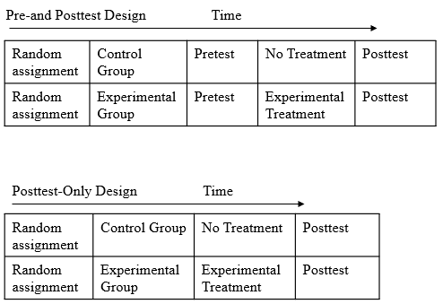
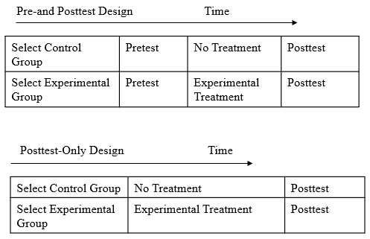
Types of Between-Group Designs
True Experimental Designs
Quasi Experimental Designs

Slide 12
Experiment Example
New “instant breakfast” product.
To assess its nutritional quality, researchers in the lab feed 30 newly weaned male white rats and measure their weight gains over a 28-day period.
They randomly select 15 rats and feed them using the new product.
The other 15 rats receive a standard diet.
Design of Experiments
Experimental units: individuals on which the experiment is done, also called subjects when the units are human beings.
The rats
Treatment: the specific experimental condition applied to the units.
“instant breakfast” diet
Factors: the explanatory variables, which often have levels.
the diet

Slide 13
Principles of Experimental Design
Control
Researcher decides which subjects are assigned to the treatment group
Randomization
Impartial and objective
Replication
Reduces chance variation in the results and can help achieve statistical significance

Slide 14
Experimental Research
Experimental Research: research that allows for the causes of behaviour to be determined
Experiment: a carefully regulated procedure where one or more factors are deliberately manipulated and all other factors are held constant.
Cause-effect relationship occurs if:
The cause is correlated with the effect.
The cause occurred before the effect.
We can rule out other plausible explanations of the causal relationship
Example: Learning effectiveness of e-Learning system

Slide 15
Experimental Research: Factors
Independent Variable (IV): factor that is manipulated
Dependent Variable (DV): factor that is measured
Experimental condition: subjects that are manipulated
Control condition: subjects that are not manipulated
Confounding variable: an extraneous variable that should be controlled, but is not. Can lead to false/spurious conclusions!
Anecdote:
Day 1: drink water + beer. Result? Drunk!
Day 2: drink water + wine. Result? Drunk!
Day 3: drink water + whiskey. Result? Drunk!
Conclusion?
Notes:
Tutoring vs. lecture example
I.V. method of teaching used
DV: posttest score
Experimental Condition: condition that is manipulated, that is the tutoring condition
Control Condition: Here it is the lecture condition
Confounding variables: tutoring requires active participation, whereas a lecture may not & tutoring involves dialog, whereas most of lecturing is a monolog given by the professor
2nd example: interested in the effect of laughter during an exam on a student’s blood pressure
IV: presence of jokes, cartoons, whatever funny material to illicit laughter
DV: blood pressure
Exper. Condition: test takers who receive funny material used to illicit laughter
Control Condition: regular test taking situation
Confounding variable:
Different senses of humor, the jokes or material that was supposed to illicit humor may not be funny at all, thus the IV really may not be causing the manipulation that we think we are testing.
3rd example: Hours of time spent studying stats effect on stats quiz/test
Imagine, I randomly assigned each of you to either study like you normally would or to study for 3 hours or to study for 6 hours
What is the IV? Hours studied, DV? Score on the quiz, Experimental group: the ones I assigned, Control group: ones I left alone, Confounding variable: overall GPA

Slide 16
Quasi Experimental Research

Slide 17
Quasi-Experimental Designs
A research design in which an experimental procedure is applied but all extraneous variables are not controlled
Characteristics of Quasi-Experimental Research
There is a control or comparison group
Intact groups are used
The treatment is not randomly assigned to groups.

Slide 18
Quasi-Experimental Research
Parametric Tests
Statistical Analysis: The t Test
For testing the significance of difference between two sample means
Analysis of Variance (ANOVA)
Comparison of two or more group means
Multivariate Analysis of Variance (MANOVA)
Statistical technique for determining whether groups differ on more than one dependent variable.
Basic Assumptions
1-Scores form an interval or ratio scale
2-Scores are normally distributed
3-Score variances for the populations under study are equal (SD=SD)

Slide 19
Quasi-Experimental (Cont’d)
Nonparametric Tests : Nonparametric statistics tests statistical significance that do not rely on any assumptions about shape or variance of population scores.
Used with measures that yield categorical or rank scores, or do not have equal intervals. Nonparametric tests are less powerful, they require larger samples to yield the same level statistical significance.
1-The Chi-Square Test = used to determine whether research data in the form of frequency counts are distributed differently for different samples.
2-The Mann-Whitney U test=used to determine whether the distributions of scores of two independent samples differ significantly from each other.
3-The Wilcox signed rank test=used to determine whether the distributions of scores of two samples differ significantly from each other when the scores of the samples are correlated.
4-The Kruskal-Wallis test=If more than two groups of subjects are to be compared, a nonparametric one-way analysis of variance (Kruskal-Wallis) can be used.

Slide 20
Quasi-Experimental Research
Quasi-experimental research
Almost but not quite real experiments
No manipulation of the variables
Compare groups biased on naturally occuring variables
Two types of natural variables
Subject variable: Characteristics that vary between participants, but can not be manipulated
Time variable: Comparing individuals at different points in time (age 3 and 6)
One-shot post-test, no control group
Example: The impact of marketing strategy
Notes:
It is not always possible (or ethical) to manipulate a condition in order to study its effects.
E.g. can’t assign a group to schizophrenia
Can’t manipulate the variables because they are already naturally manipulated
Subject variables: Age, gender, IQ, school or school system attended

Slide 21
Diagramming Research
To illustrate research designs, a number of symbols are used
X₁ = Treatment
X₂ = Control Group
O = Observation (pretest or posttest)
R = Random Assignment
A Sample Research Design
Single-Group Pretest-Treatment-Posttest Design
This means subjects are randomly assigned to a group, which is then given a pretest, then there is a treatment, then there is a posttest.
R O X₁ O

Slide 22
Classification of Research Design (Causal Comparative)
O1
X
O2
One-group pretest-posttest design
Group 1:
O1
X
O2
Nonequivalent control group
Group 2:
O3
O4
X1
O1
X2
O2
Equivalent time-samples design

Slide 23
Research design with more power (time series)
Pre-test post-test
O₁ O₂ O₃ X O₄ O₅ O₆
Pre-test post-test with control group
O₁ O₂ O₃ X O₄ O₅ O₆
O₁ O₂ O₃ O₄ O₅ O₆

Slide 24
Changes to Look For
No effect
Change in the rate or slope
Change in the intercept
X
TIME

Slide 25
Non Experimental Research

Slide 26
Research Designs by Similarities
Experimental & Quasi-experimental
-Involves Researcher Intervention
Non-experimental
- Examines phenomena as they exist
Descriptive
Causal-Comparative
Correlational

Slide 27
Descriptive Research
Purpose
To describe the way things are
Or “what is”
Many of the methods used, can also be used for correlational research
Difference is the purpose
describing v. examining a relation
Two main types
Surveys
Observations
Objective: Describe market characteristics or functions
Characteristics:
Marked by the prior formulation of specific hypotheses
Preplanned and structured design
Methods: Secondary data
Surveys
Panels
Observation and other data
Notes:
Method type I often used to describe design. E.g., survey research

Slide 28
Causal-Comparative Research
The Purpose
Purpose of explaining educational phenomena through the study of cause-and-effect relationships. The presumed cause is called the independent variable and the presumed effect is called the dependent variable. Designs where the researcher does not manipulate the independent variable are called ex post facto research.
Ex Post Facto = Causal-Comparative Research
Explores possible causes and effects
The independent variable is not manipulated, it has already been applied
Focuses first on the effect, then attempts to determine what caused the observed effect.
Seeks to explain differences between two groups that have occurred
Example: Why are IT multinational companies are more innovative than local firms?

Slide 29
Correlational Designs
The Purpose
To discover relationships between variables through the use of correlational statistics. Involves correlating data on two or more variables for each individual in a sample and computing a correlation coefficient.
Two major purposes:
1-To explore causal relationships between variables;
2-To predict scores on one variable from research participants’ scores on other variables.
Advantages
1-Enables researchers to analyze the relationships among a large number of variables in a single study.
2-They provide information concerning the degree of the relationship between the variables being studied.
Parametric Test
Pearson r statistical procedure
Basic Assumptions
1-Scores form an interval or ratio scale
2-Scores are normally distributed
3-Score variances for the populations under study are equal (SD=SD)

Slide 30
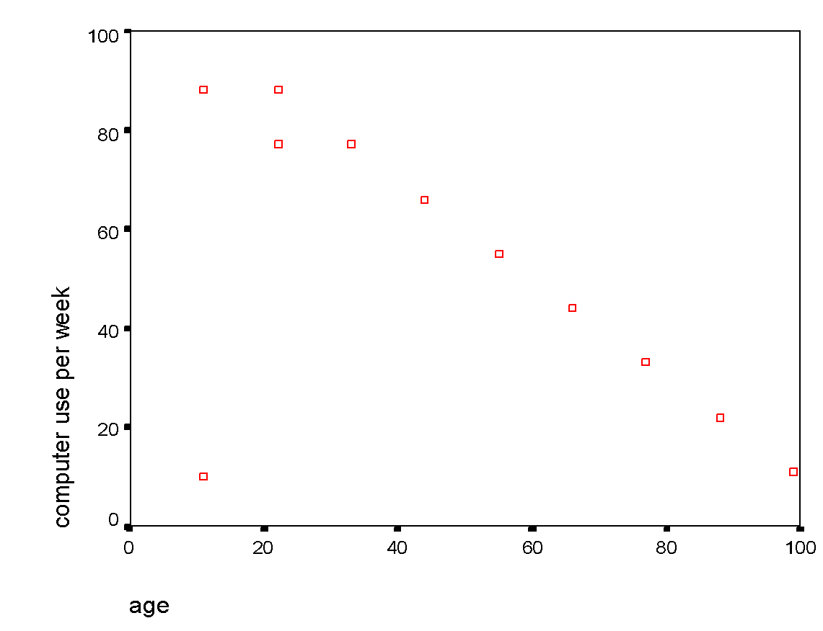
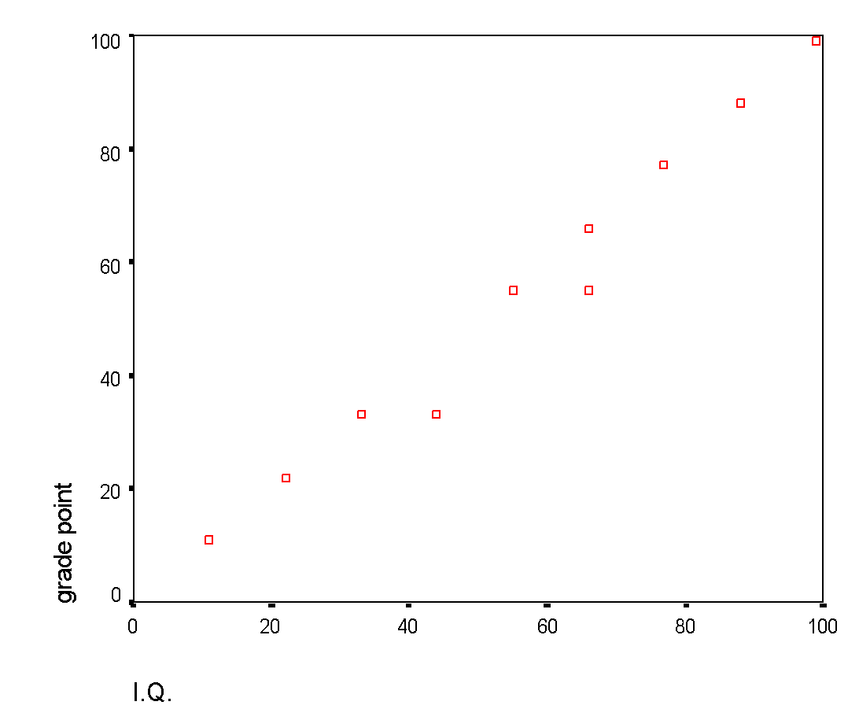
Scattergrams Representing Different Degrees and Directions of Correlation between Two Variables
Positive correlation (r=.99)
Negative correlation (r=-.73)
Grade point
I.Q.
Age
Computer use

Slide 31
Conclusion : Experimental Research Design
Experimental Research
Design
Design with
Threats to
Internal Validity
Requirements of
Experimental
Research Design
Pre-testing
Participant
True Research
Design
Choice of
Research Design
One-Group
Posttest-Only
Posttest-Only
Pretest-Posttest
Research Question
One-Group
Pretest-Posttest
Between-Participants
Control
Nonequivalent
Posttest-Only
Mixed Models
Within Participants
Simple Randomized
Between Vs. Within
Participants design
Factorial
Sumber: Christensen, Larry B. 2007

